Slide 1


SMART INDIA HACKATHON 2025
Team Details and Problem Statement
Problem Statement ID – SIH25259
Problem Statement Title- Recovery and reuse of Fresh water resources
Theme- Clean & Green Technology
PS Category- Software
Team ID- 30
Team Name (Registered on portal)- Intellicraft

Slide 2
A blockchain enabled smart water reuse and monitoring system
Intellicraft
Proposed solution:
- We propose a Blockchain and IoT-based system to monitor, record, and promote reuse of freshwater resources at domestic, industrial, and municipal levels.
- The system combines smart water sensors, IoT devices, and AI analytics to track usage, wastage, and reuse potential.
- Blockchain integration ensures transparent and tamper-proof records of water data, consumption logs, and reuse metrics.
- A mobile/web dashboard displays real-time statistics, alerts, and water-quality indicators for users and authorities.
- The app provides reuse suggestions (e.g., use treated greywater for gardening, cooling systems, or flushing).
.
Cloud data storage allows multi-level access for citizens, communities, and municipal bodies.
AI-based analysis helps predict water demand and identify high-consumption zones for better planning.
Users are rewarded for sustainable behaviour through a digital points system, encouraging active participation.
The system enables transparency, accountability, and efficient resource management.
Aligns with UN Sustainable Development Goal 6
- Clean Water and Sanitation and supports India’s Jal Jeevan Mission

Slide 3
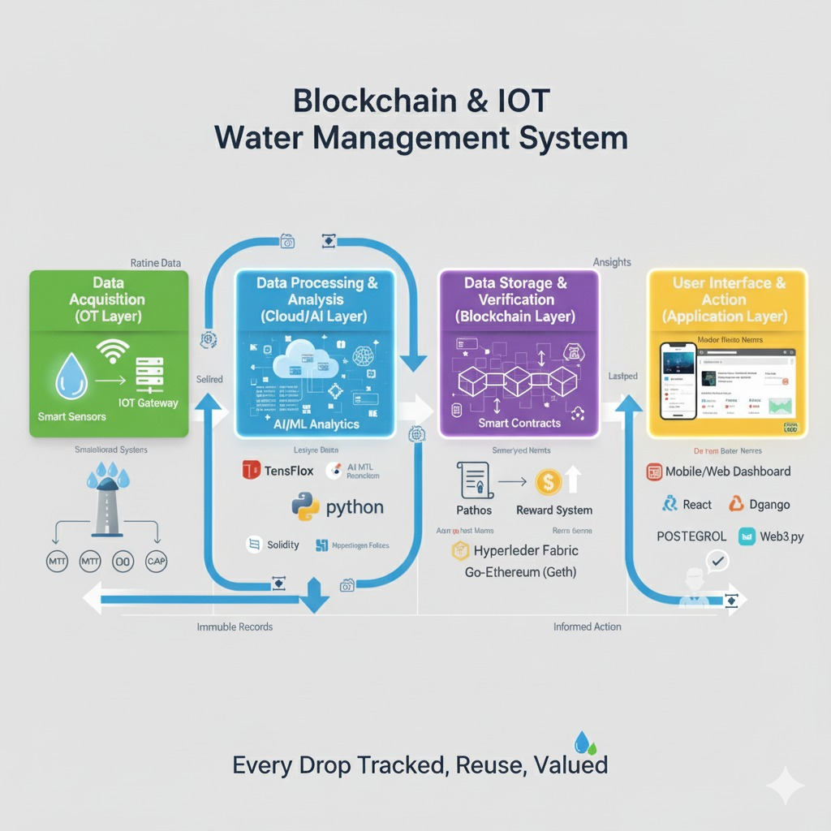
TECHNICAL APPROACH
Intellicraft

Slide 4
FEASIBILITY AND VIABILITY
Intellicraft
RISK | IMPACT | MITIGATION
Sensor malfunction or inaccuracy | Incorrect reading may affect reuse data | Use high quality IoT sensors with periodic calibration alerts
Data security and privacy issues | Unauthorized access to water consumption data | Blockchain ensures tamper proof and transparent data handling
Connectivity issues in rural/low network areas | Real time monitoring may get delayed | Enable offline data buffering auto-sync once connectivity is restored

Slide 5
IMPACT AND BENEFITS
Intellicraft
POTENTIAL IMPACT ON TARGETED AUDIENCE
FOR USERS / HOUSEHOLDS:
Real-time insights on water consumption and reuse efficiency.
Encourages responsible usage through alerts and reward-based motivation.
FOR GOVERNMENT & AUTHORITIES:
Ensures transparency and accountability through blockchain-based data logging.
Helps monitor progress of Jal Jeevan Mission and SDG 6 (Clean Water & Sanitation) targets.
FOR SOCIETY & ENVIRONMENT:
Decreases groundwater exploitation and improves long-term availability.
Encourages the development of smart, eco-friendly cities.
BENEFITS
Our solution delivers social, environmental, and economic value by combining technology with sustainability:
Efficiency: Real-time monitoring for smarter resource allocation.
Sustainability: Promotes circular water usage and conservation.
Transparency: Blockchain ensures secure, tamper-proof data.
Affordability: Low-cost IoT setup and minimal maintenance.
Scalability: Can be implemented across homes, societies, and industries.

Slide 6
RESEARCH AND REFERENCES
Intellicraft

